Slide 1
Infinity DBX Estimations & Scrum Ceremonies
December, 2019

Slide 2
Estimation
Metrics, Maturity Models & Review
Q & A
Scrum Ceremonies- Quick Recap
Agenda

Slide 3
Estimations
Agile teams use story points to estimate the level of work required to complete the story
Why estimations are important?
To understand when can a certain set of product backlog items be delivered
Required for PO to prioritize the work to maximize the value that each scrum team delivers
To ensure adequate amount of work is pulled into the sprints
A story point is a singular number that represents a combination of qualities:
Volume – How much is there?
Complexity – How hard is it?
Knowledge – What’s known?
Uncertainty – What’s unknown?
Team has to use below notion of Fibonacci series for estimation: 1, 2, 3, 5, 8. Stories exceeding 8 pointers should be sliced further.
Notes:
I can talk about examples for volume / complexity/ Knowledge/ Uncertainty: what happens when estimations are not done and how it will be helpful if estimations are done

Slide 4
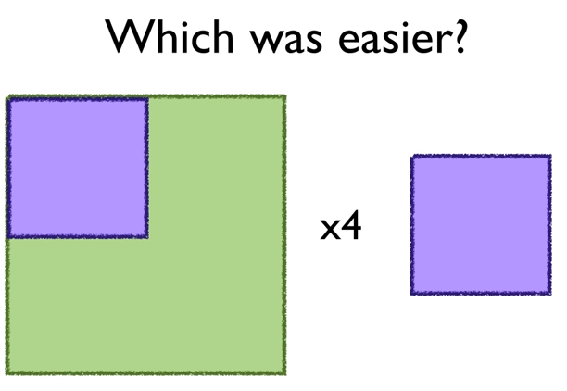
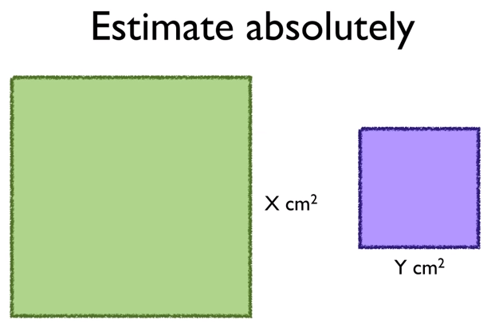
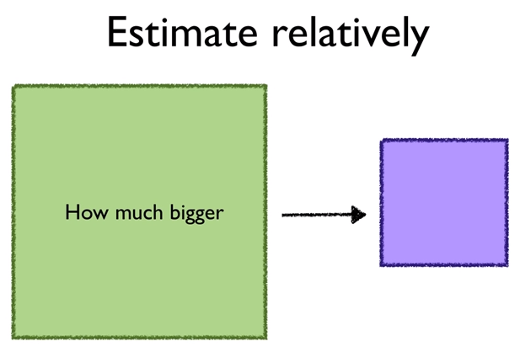
Estimation Technique
Sizing of all the user stories should be done based on relative estimation technique i.e. comparing each story against a baseline story
The base can be decided by scrum teams based on story complexity/ effort.
Other stories can then be estimated relatively.
Why Relative Estimation?

Slide 5
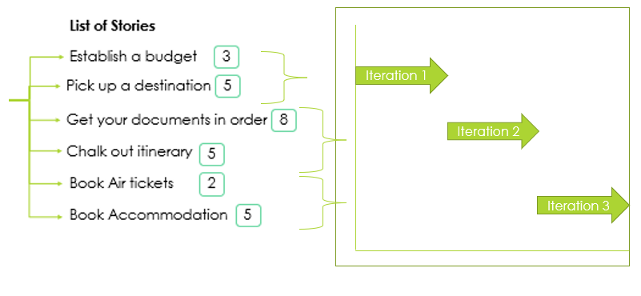
Let’s run this through an example
List of Stories
3
Establish a budget
Planning a trip to Europe
Pick up a destination
5
Get your documents in order
8
2
5
8
Chalk out itinerary
5
Book Air tickets
2
Book Accommodation
5

Slide 6

Planning Poker
A consensus-based estimating approach
Involves Entire Scrum Team
Product Owner discusses a feature
All Scrum team members estimate
In case of difference of estimates, team discusses the estimates
Team concludes on one story point for each story

Slide 7



Slide 8
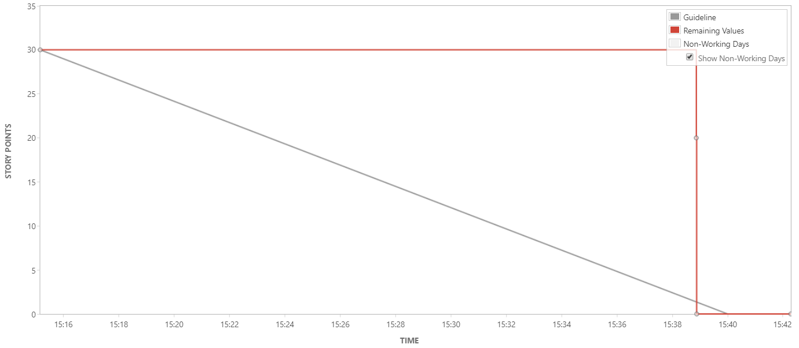

Metrics & Jira Reports
Burndown charts
Track the total work remaining in a sprint and project the likelihood of achieving the sprint goal. This helps your team manage its progress and respond accordingly
Case 1: Current State (For most teams)
Teams did not update status of stories in Jira
OR
Stories are not small enough to be completed in 1-5 days
2
1
3
1
Estimation Statistic
2
Remaining Values
3
Guideline

Slide 9
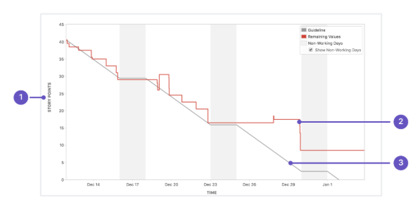
Metrics & Jira Reports
Burndown charts
Track the total work remaining in a sprint and project the likelihood of achieving the sprint goal. This helps your team manage its progress and respond accordingly
Case 2: Expected
Stories were vertically sliced and were small enough to be completed rapidly
Team diligently updated status of stories through the sprint
Scope Creep
1
Estimation Statistic
2
Remaining Values
3
Guideline

Slide 10
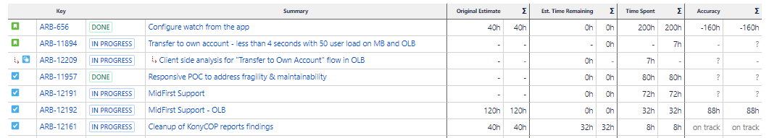
Metrics & Jira Reports
How to determine accuracy of estimates?
When scrum team logs in the actual time taken by them to complete a story, it helps to determine the accuracy of estimates using Jira’s inbuilt progress tracking report.
This helps team to reflect back and improve on the estimates for similar tasks in upcoming sprints.
It also helps to generate burndown based on time remaining and improves predictability

Slide 11
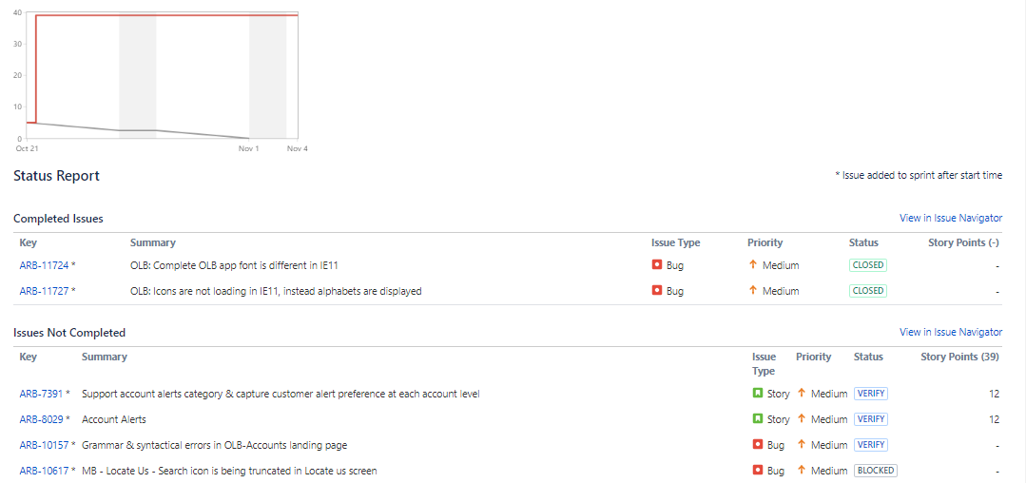
Metrics & Jira Reports
Sprint Reports
Helps to understand the work completed or pushed back to the backlog in each sprint. This helps to determine if the team is overcommitting or if there is excessive scope creep.

Slide 12
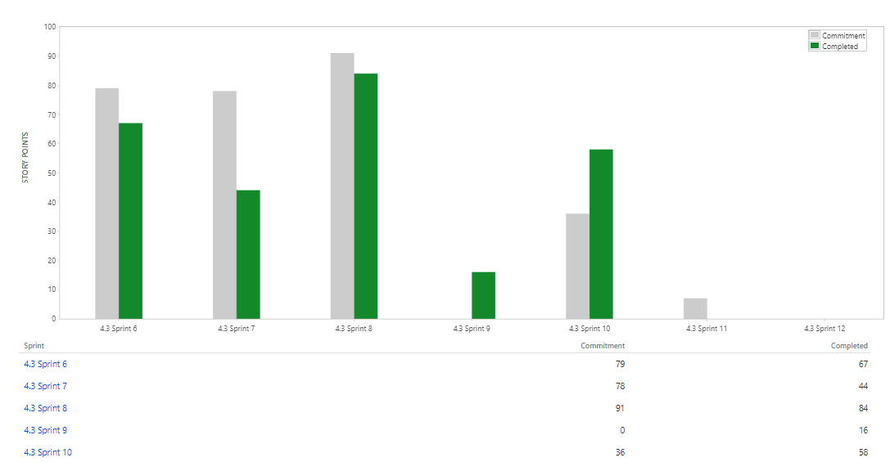
Metrics & Jira Reports
Velocity Report
Helps to track the amount of work completed from sprint to sprint. This helps you determine your team's velocity and estimate the work your team can realistically achieve in future sprints.
Teams need to ensure story review is completed within the sprint and story should be moved to Done within the sprint to get accurate velocity calculations

Slide 13
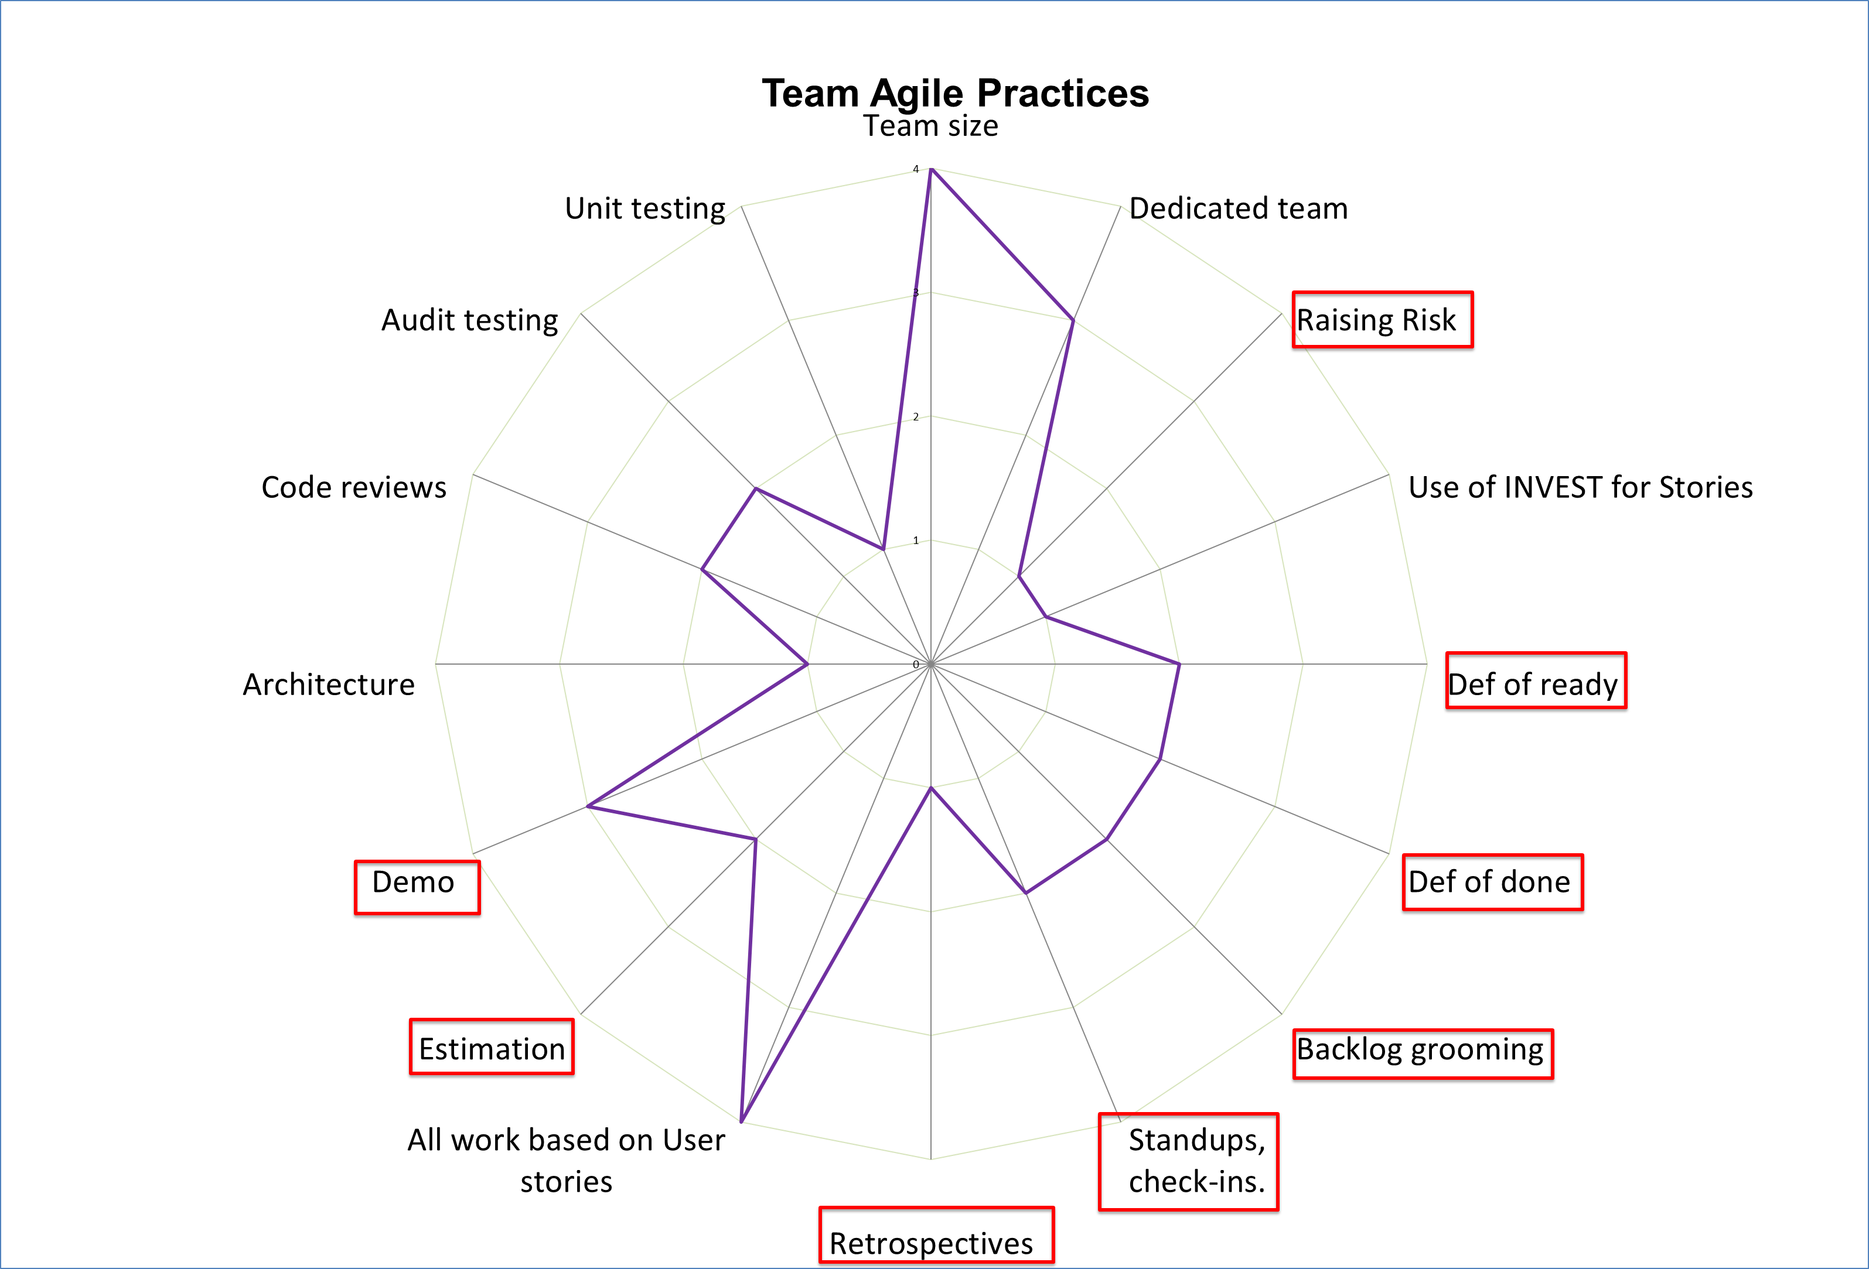
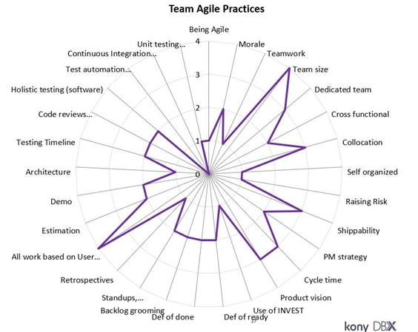
Agile Maturity Model & Review
High Quality Release
Areas of Focus
Refer criteria for each of the parameter in the template here

Slide 14
Scrum Ceremonies
High Quality Release
Daily Scrum
Sprint Planning
Backlog Grooming
Sprint Demo
Sprint Retrospection
Daily Scrum
This is a daily sync up within scrum team which allows team to coordinate and align their effort for the day.
Expectation:
Scrum team to meet daily without fail and identify challenges, determine progress made and ensure scrum boards are updated.
Sprint Planning
An event where scrum team meets and defines sprint goals by pulling in items from backlog
Expectation:
Teams shall set up a regular sync up for getting a defined list of items for upcoming sprint. As an output scrum teams should have the scrum boards ready for next sprint with estimations for stories.
Backlog Grooming
Product backlog refinement ensures teams review, discuss and elaborate on requirements for upcoming sprints
Expectation:
Each team should conduct backlog grooming sessions in each sprint. As an end output teams shall understand the feature, split it into stories and tentatively schedule them into upcoming Iterations in the team backlog
Sprint Demo
Significant event where Scrum team demonstrates the completed stories at the end of each sprint and gather feedback
Expectation:
Teams to set up a sprint demo at the end of each sprint with all major stakeholders and plan to incorporate feedback in next sprint
Sprint Retrospection
This cadence helps the scrum team to reflect back on the sprint and identify the items that need improvements while appreciating all goo practices to be continued
Expectation:
Teams to set up a regular retrospective cadence with all team members providing feedback and recording the feedback and action items in confluence.
Participants:
Entire Scrum Team
Scrum Team + UI/UX
Scrum Team + UI/UX+ Dependent Team leads
Entire Scrum Team+ other relevant stake holders+ QA+ Documentation
Scrum Team + UI/UX

Slide 15
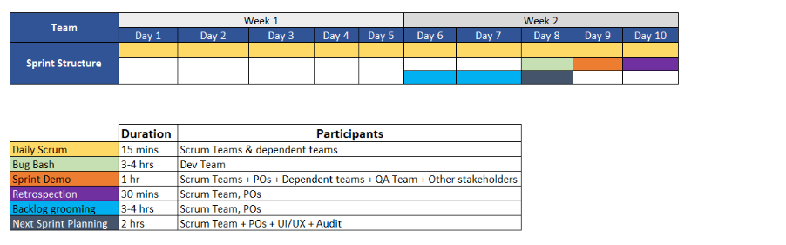
Sprint Structure (Recommended)
High Quality Release

Slide 16
Q & A
High Quality Release

Slide 17
Thank You
High Quality Release

Slide 18
References
High Quality Release
https://www.youtube.com/watch?time_continue=424&v=sCCUEtjCpCs&feature=emb_logo
https://www.youtube.com/watch?v=TxSzo3lwwWQ

